Slide 1
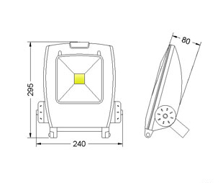
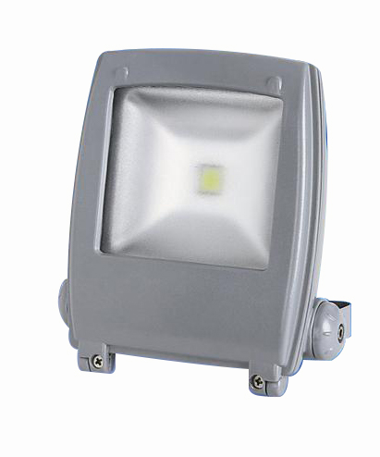
Flood Lighting
PRODUCT SPECIFICATION OVERVIEW
Model No. | Description
FL900/1H/MT/MH | 220-240AC input, charge 24 hours, discharge 1 hour, 9.6V1.8Ah Ni-Mh battery, provided 1000lm output. manual test
FL900/1H/MT/MH | 220-240AC input, charge 24 hours, discharge 1 hour, 9.6V1.8Ah Ni-Mh battery, provided 1000lm output. manual test
FL900/3H/AT/MH | 220-240AC input, charge 24 hours, discharge 3 hours, 9.6V1.8Ah Ni-Mh battery, provided 400lm output. AUTO test
FL900/3H/AT/MH | 220-240AC input, charge 24 hours, discharge 3 hours, 9.6V1.8Ah Ni-Mh battery, provided 400lm output. AUTO test

Slide 2
Flood Lighting
Specification
Rated Power Supply | 220-240VAC 50Hz
Power consumption | Max. 4W
Charge time | 24 hours
Discharge duration | 1hour /3 hours
Test facility | AUTO test
Operation | Non-maintained
Mounting | Wall mounting
Lamp type | PHILIPS SMD 2323 LED, CCT 6000K, CRI>80
Battery type | Ni-MH battery
Normal flux | 1000 lm for 1 hour model, 400lm for 3 hours model
Housing material | Metal chassis with powder finish
Lamp material | Plastic
Protection degree | IP65
Ambient temperature | 0℃…+40℃

Slide 3
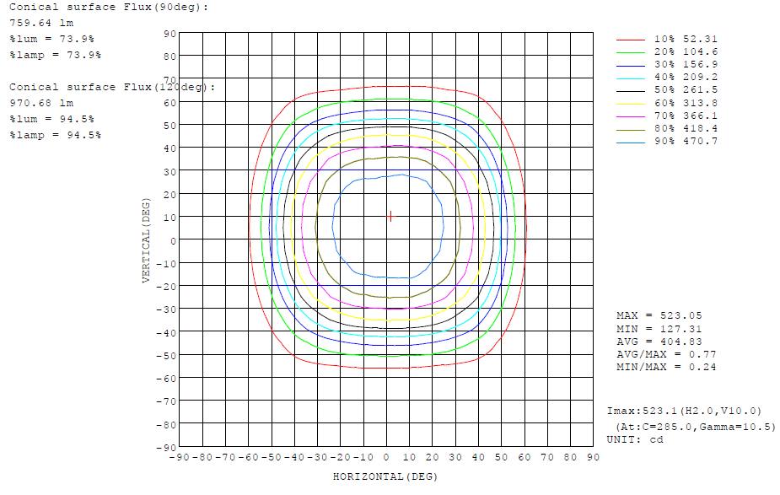
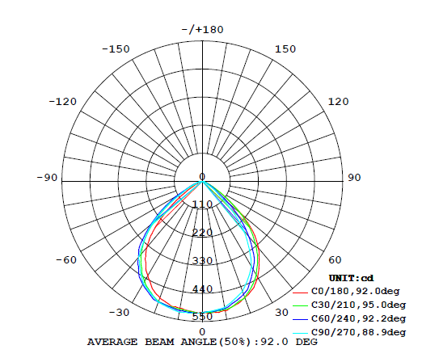
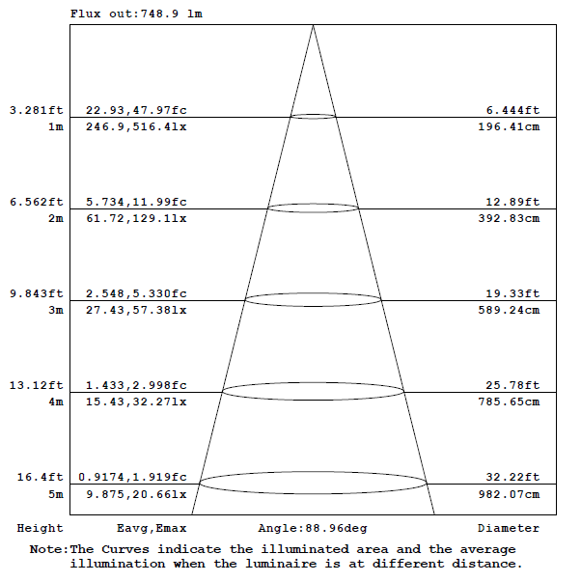
Flood Lighting
LUMINOUS INTENSITY DISTRIBUTION DIAGRAM
AAI Figure
ISOCANDELA DIAGRAM

